Slide 1

Home Automation By:- !ABHIMANYU
Members:-
PURUSHOTAM KUMAR AGRAWAL
PRABHJOUT SINGH ARORA
RIYA KUMARI
HARSH KUMAR SINGH
SATENDRA SINGH PATEL

Slide 2

What is it all about
Home automation is a network of hardware, communication, and electronic interfaces that work to integrate everyday devices with one another via the Internet. Each device has sensors and is connected through Wi-Fi, so you can manage them from your smartphone or tablet whether you’re at home, or miles away.

Slide 3

HOME SECURITY
ELECTRONIC LOCK

Slide 4

IMPLEMENTING PASSWORD BASED ACCESS
USING ESP8266 Serial WIFI Wireless Transceiver Module and Blynk app, we have Implemented password Security.
On entering Correct Password the person will be able to access the home components
On entering Incorrect password Four times an instant warning notification will be sent to owner, followed by an E-mail to his provided mailing address. There will be a security breach sign will be displayed on the LCD monitor along with that, the breach will be also there on the Think Speak server, and the Home will be locked until it rest again with right password.
Not only this, if some tries to enter in home, without password. The same process will be followed.

Slide 5
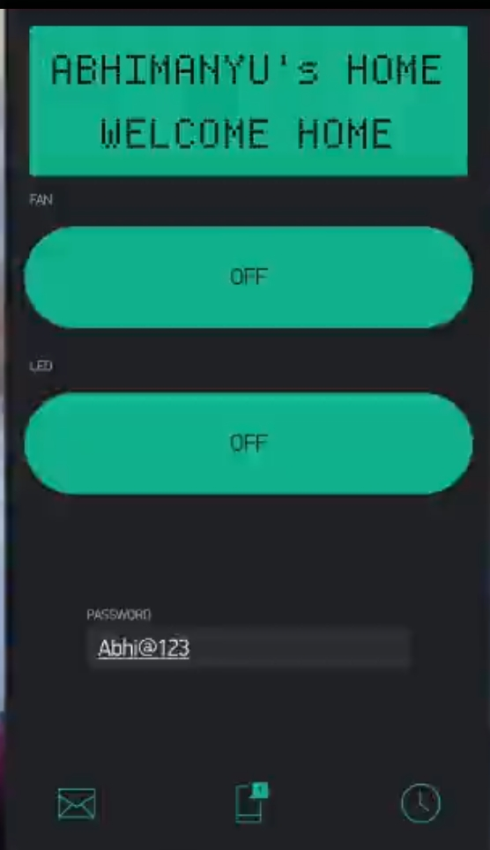
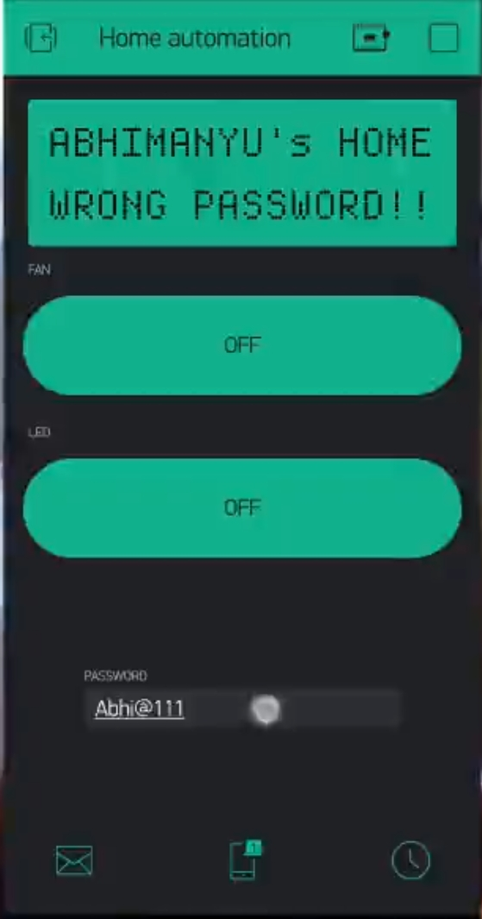
Our user interface
With Correct password
With Incorrect password

Slide 6
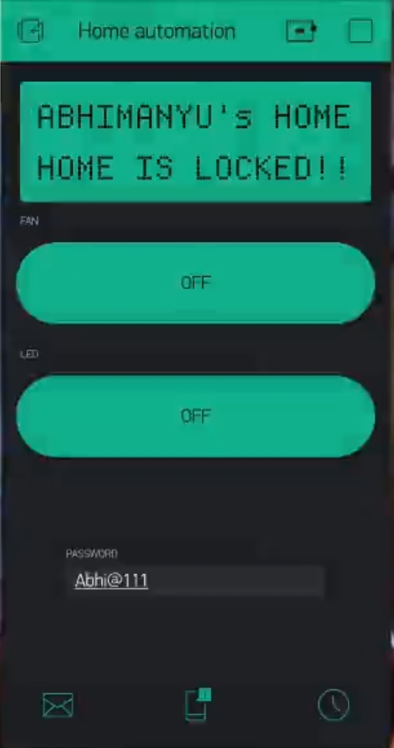
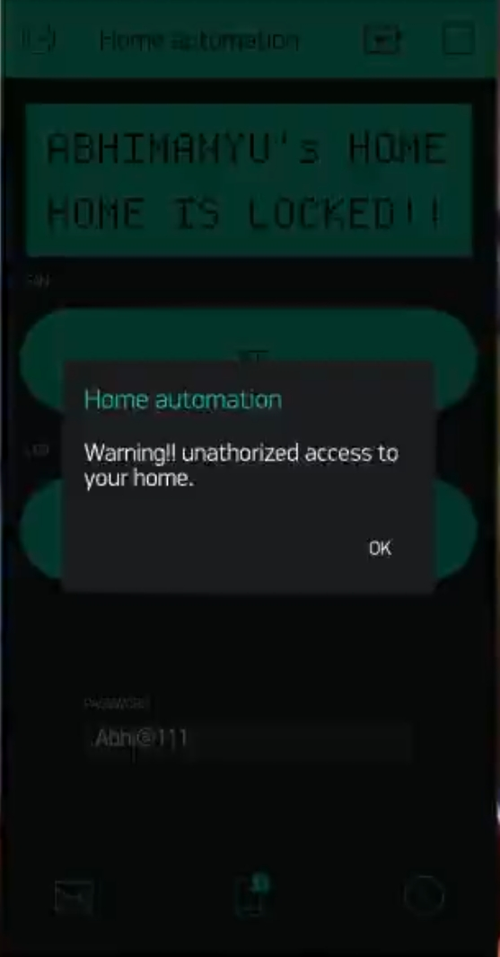
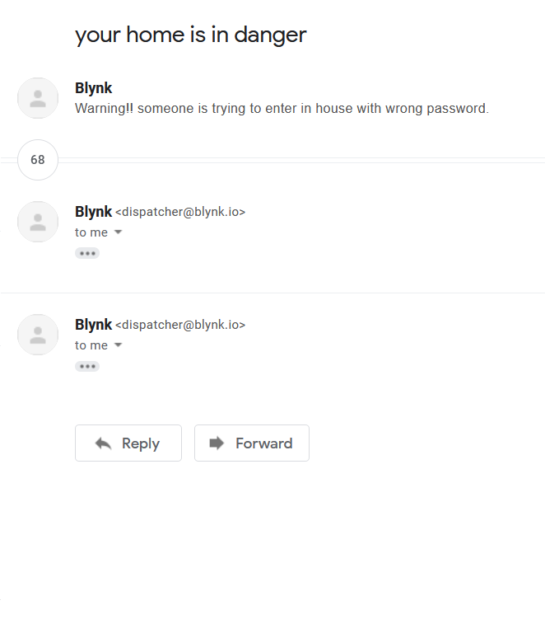
Provision of Alarm on wrong password and Unauthorized Access

Slide 7
Advanced Security Ideas
Using Third Eye:-It Basically Captures the snap of the Intruder.
Burglar Alarm
Mailing The Report To nearby Police Authority With Secret Snap + GPS Location Of the Place

Slide 8

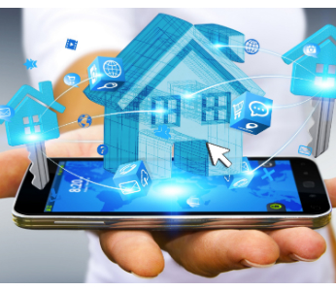
SMART HOME
Smart home technology provides security comfort, convenience and energy efficiency by allowing them to control smart devices, often by a smart home app on our smartphone or other networked device.

Slide 9
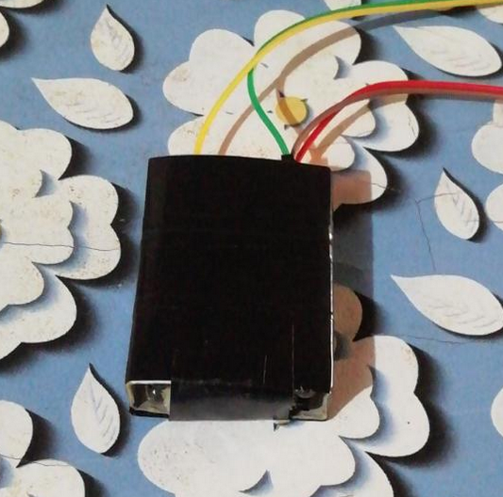
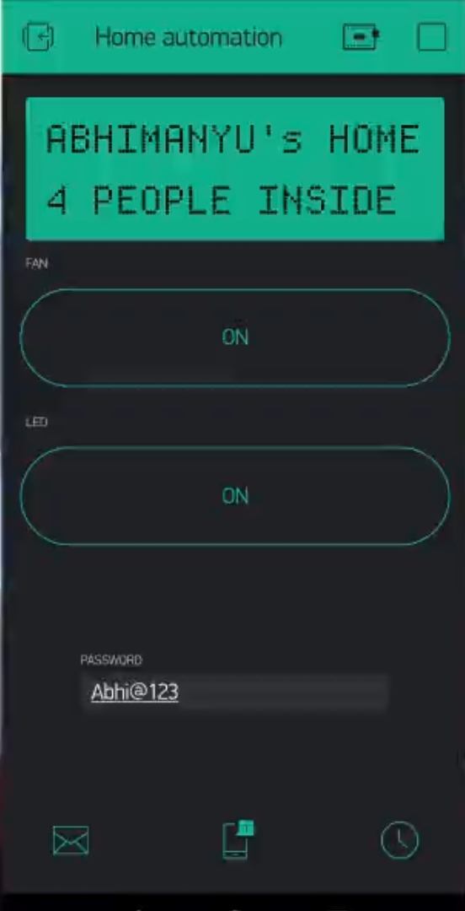
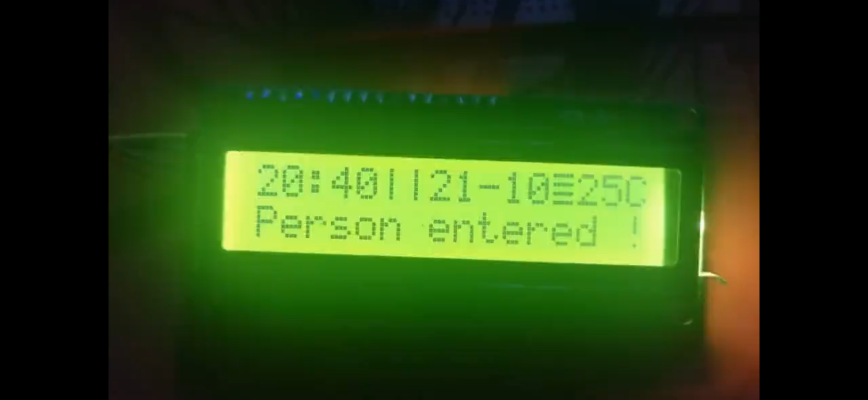
Counting no. of Persons
Used 2 IR sensors to accurately count the incoming and outgoing person with directions.

Slide 10
Controlling Bulb Brightness And Speed of the Fan
The brightness of the light will depend on the surrounding light and adjust accordingly.
The speed of fan is controlled by temperature as well as the no. Of people inside.
If everyone will leave the home, with lights and fans on( as usual ). Our system will shut that down automatically.
The whole system is designed to give you an energy efficient, smart and comfortable home to live within

Slide 11
24/7 monitoring on LCD 16x2 Display
An LCD (Liquid Crystal Display) screen is an electronic display module and has a wide range of applications. A 16x2 LCD display is very basic module and is very commonly used in various devices and circuits. A 16x2 LCD means it can display 16 characters per line and there are 2 such lines.
We used this device to show all the basic information of our home. More on that ahead.

Slide 12
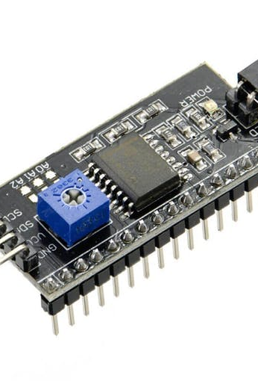
I2C Serial Interface Adapter
It has total of 20 male pins. 16 pins are faced to rear side and 4 pins faced towards front side. The 16 pins for connect to 16x2 LCD and the 2 pins out of 4 pins are SDA and SCL. SDA is the serial data pin and SCL is the clock pin. The rest 2 pins for power supply (Vcc and ground).

Slide 13
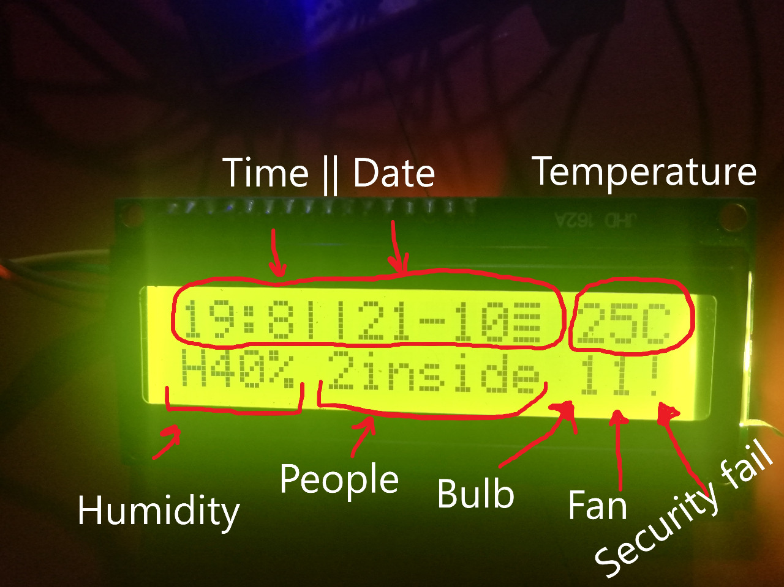
Parameters Displayed
TIME
DATE
TEMPERATURE
HUMIDITY
NO OF PEOPLE
STATE OF FAN
STATE OF BULB
HOME SECURITY WARNING

Slide 14
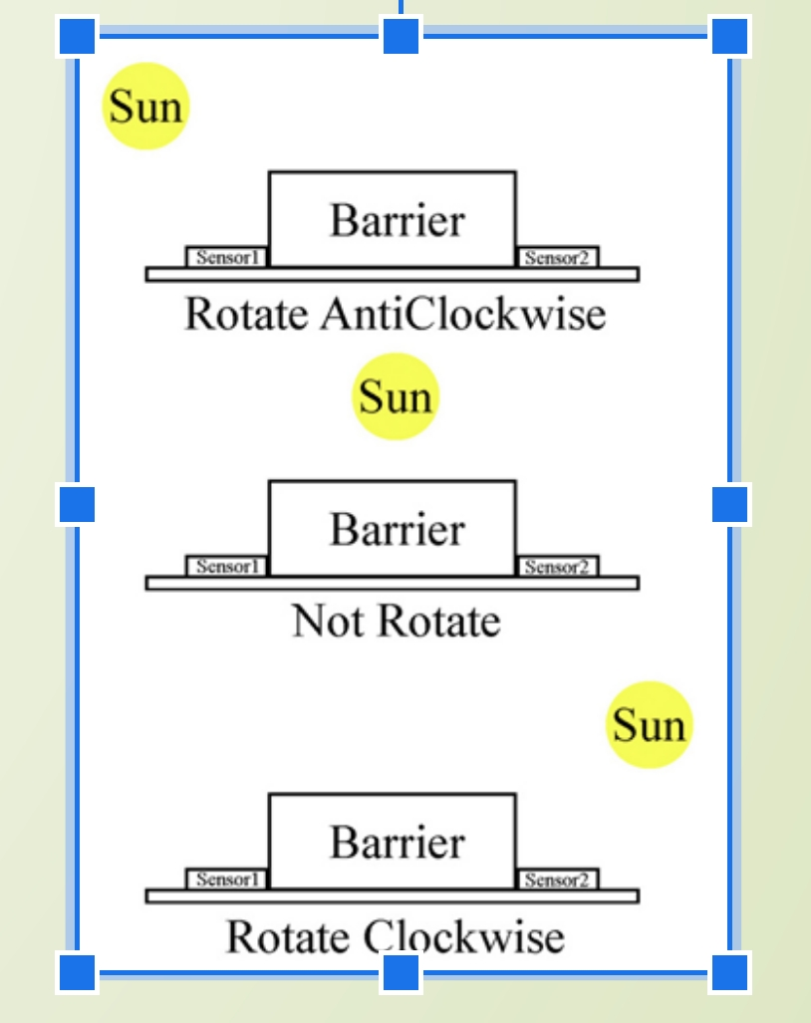
AUTOMATED SOLAR TRACKER
The two LDR’s are placed at the two sides of solar panel and the Servo motor is used to rotate the solar panel. The servo will move the solar panel towards the LDR whose resistance will be low, mean towards the LDR on which light is falling, that way it will keep following the light. And if there is same amount of light falling on both the LDR, then servo will not rotate.
The servo will try to move the solar panel in the position where both LDR’s will have the same resistance means where same amount of light will fall on both the resistors and if resistance of one of the LDR will change then it rotates towards lower resistance LDR

Slide 15
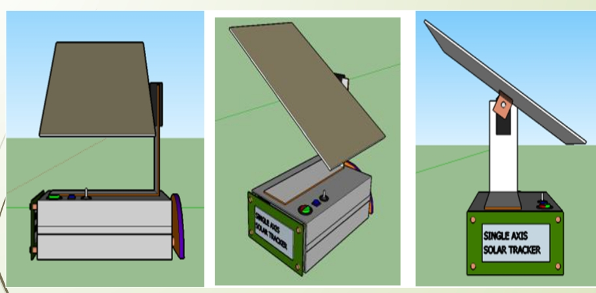

Slide 16
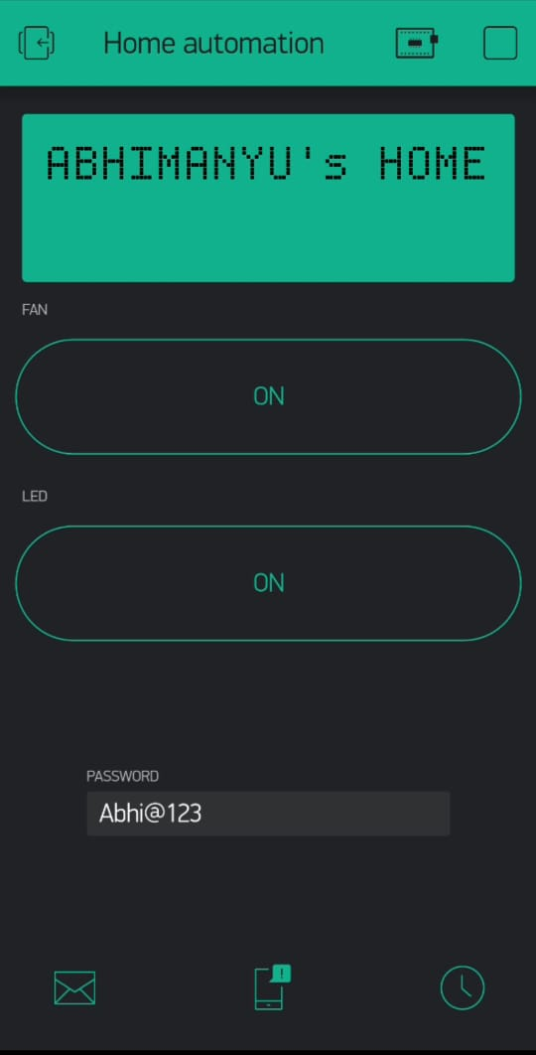
Smart Switching
Control Appliance Using Wireless Communication

Slide 17
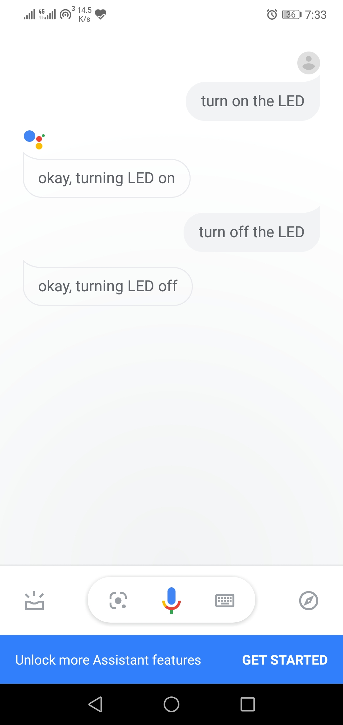
Switching of appliances
Voice controlled
Simple switching by Blynk app
More on these ahead

Slide 18

Internet of things(IoT)
IoT, a very fancy word to hear. We used its concept in order to make our home smatter.
We look all those fancy stuff like security alarm and other warning systems along with the password entry is done by IoT.
We switched things on/off over internet using our mobile app and voice command is possible by IoT.
All our data is uploaded on a server provided by ThingSpeak in real time.
In short it connects our home globally.

Slide 19
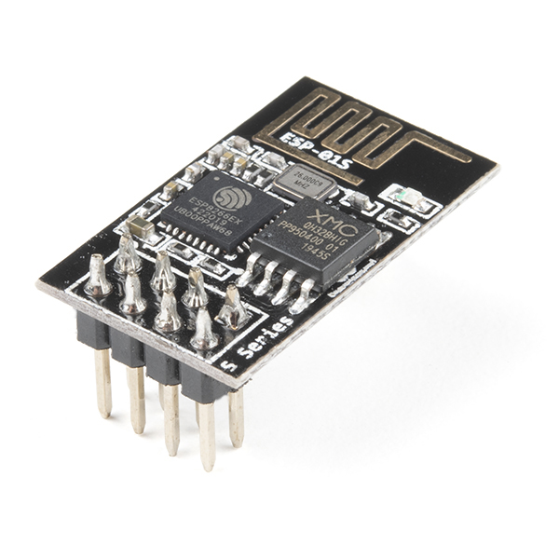
ESP8266 Wi-Fi Module
The ESP8266 Wi-Fi Module is a self-contained SOC with integrated TCP/IP protocol stack that can give any microcontroller access to your Wi-Fi network. The ESP8266 is capable of either hosting an application or offloading all Wi-Fi networking functions from another application processor

Slide 20
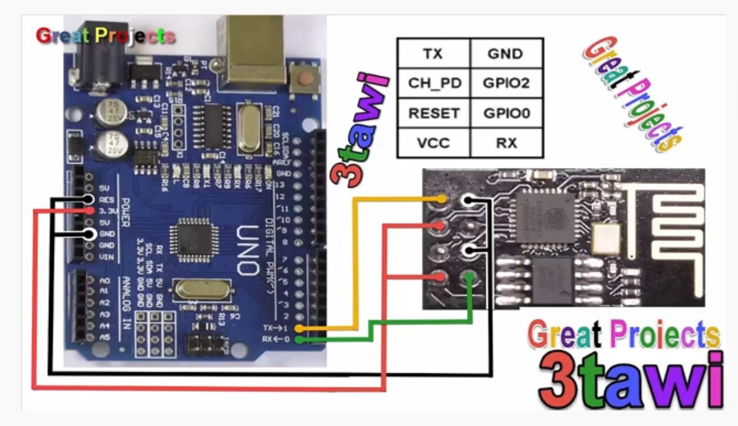
Configuration to upload code in ESP8266 Wi-Fi Module via Arduino UNO

Slide 21

Let's Blink with
We used the blynk app to satisfy many of our IoT needs.
We used password entering interface.
We used notification tool to send warning alerts.
We used Switches to control our home appliances with this app.
We used Email delivery system of blynk.
We imported time and date from it.
And at last but not least, we used its LCD display to display all the info in real time.

Slide 22

The things will speak with ThingSpeak
We used to upload all the data on the TinkgSpeak sever as log, also display in almost real time {just 1 min delay}.
We uploaded data like-
Security fail log.
Current state of fan and bulb.
No. Of person visited home.
Temperature and humidity.

Slide 23

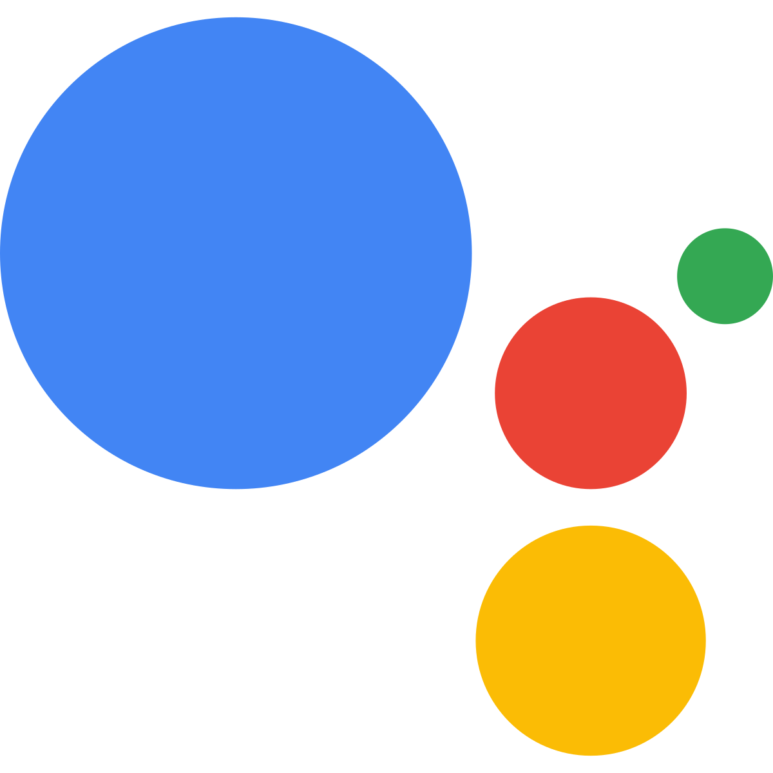

Voice command IFTTT, google assistance, webhook and Blynk
The process is rather simple.
The IFTTT will hear the request by google assistance, when we give command.
It then sends the message to Blynk app using webhook. In short this will hit a URL of Blynk to send the on/off signal.

Slide 24
And with this, we finished our all projects with flying colors
Codes
ESP8266 click here
Arduino UNO click here

Slide 25
Thank you

